Slide 1
Composition: main gases (nitrogen and oxygen)

Slide 2
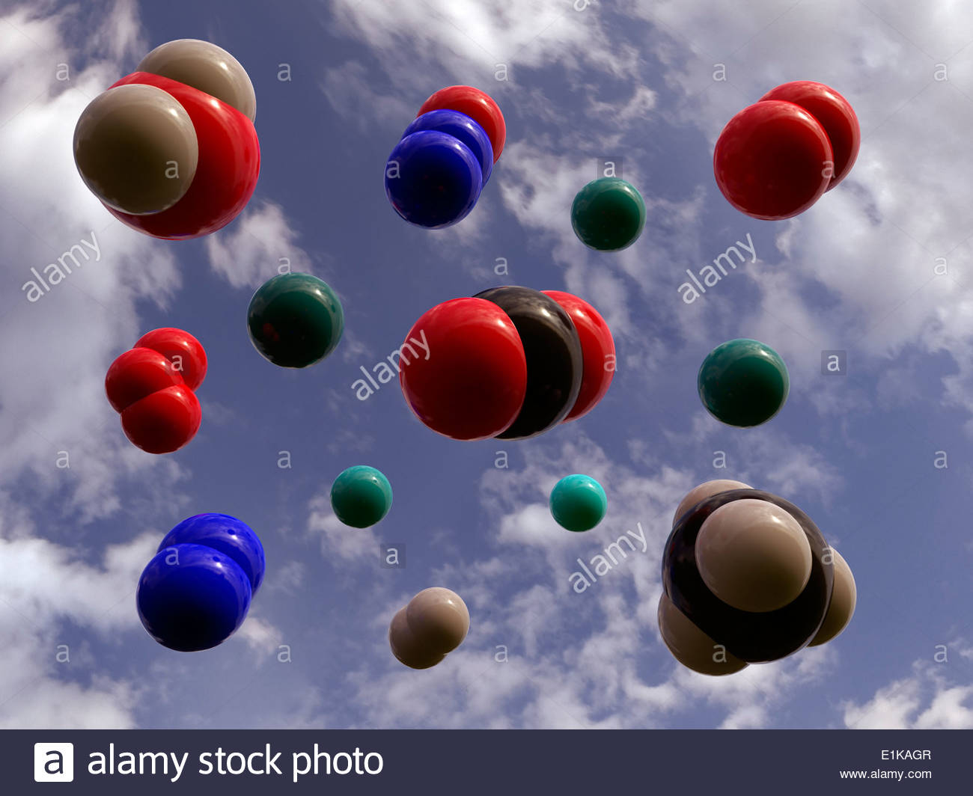
Can you match images to names (and formulas)?
Main constituents:
Nitrogen (N₂)
Oxygen (O₂)
Secondary:
Water vapor (H₂O)
Argon (Ar)
Trace amounts:
Carbon dioxide (CO₂)
Nitrous oxide (N₂O)
Methane (CH₄)
Ozone (O₃)

Slide 3
Can you match images to names (and formulas)?
Main constituents:
Nitrogen (N₂)
Oxygen (O₂)
Secondary:
Water vapor (H₂O)
Argon (Ar)
Trace amounts:
Carbon dioxide (CO₂)
Nitrous oxide (N₂O)
Methane (CH₄)
Ozone (O₃)

Slide 4
Here are the main gases – can you match images to names (and formulas)?
Main constituents:
Nitrogen (N₂)
Oxygen (O₂)
Secondary:
Water vapor (H₂O)
Argon (Ar)
Trace amounts:
Carbon dioxide (CO₂)
Nitrous oxide (N₂O)
Methane (CH₄)
Ozone (O₃)

Slide 5
Secondary & trace gases

Slide 6
Secondary/trace gases: can you match images to names (and formulas)?
Main constituents:
Nitrogen (N₂)
Oxygen (O₂)
Secondary:
Water vapor (H₂O)
Argon (Ar)
Trace amounts:
Carbon dioxide (CO₂)
Nitrous oxide (N₂O)
Methane (CH₄)
Ozone (O₃)

Slide 7
Secondary/trace gases: can you match images to names (and formulas)?
Main constituents:
Nitrogen (N₂)
Oxygen (O₂)
Secondary:
Water vapor (H₂O)
Argon (Ar)
Trace amounts:
Carbon dioxide (CO₂)
Nitrous oxide (N₂O)
Methane (CH₄)
Ozone (O₃)

Slide 8
Secondary/trace gases: can you match images to names (and formulas)?
Main constituents:
Nitrogen (N₂)
Oxygen (O₂)
Secondary:
Water vapor (H₂O)
Argon (Ar)
Trace amounts:
Carbon dioxide (CO₂)
Nitrous oxide (N₂O)
Methane (CH₄)
Ozone (O₃)

Slide 9
Secondary/trace gases: can you match images to names (and formulas)?
Main constituents:
Nitrogen (N₂)
Oxygen (O₂)
Secondary:
Water vapor (H₂O)
Argon (Ar)
Trace amounts:
Carbon dioxide (CO₂)
Nitrous oxide (N₂O)
Methane (CH₄)
Ozone (O₃)

Slide 10
Secondary/trace gases: can you match images to names (and formulas)?
Main constituents:
Nitrogen (N₂)
Oxygen (O₂)
Secondary:
Water vapor (H₂O)
Argon (Ar)
Trace amounts:
Carbon dioxide (CO₂)
Nitrous oxide (N₂O)
Methane (CH₄)
Ozone (O₃)

Slide 11
Secondary/trace gases: can you match images to names (and formulas)?
Main constituents:
Nitrogen (N₂)
Oxygen (O₂)
Secondary:
Water vapor (H₂O)
Argon (Ar)
Trace amounts:
Carbon dioxide (CO₂)
Nitrous oxide (N₂O)
Methane (CH₄)
Ozone (O₃)

Slide 12
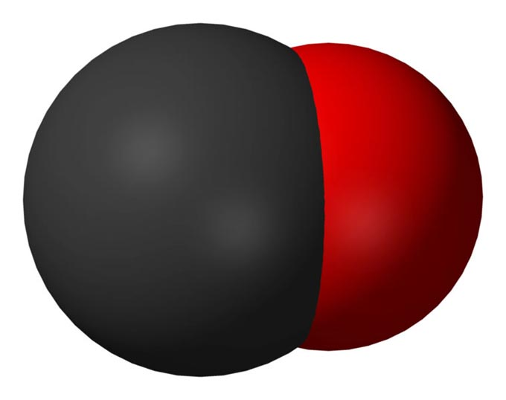
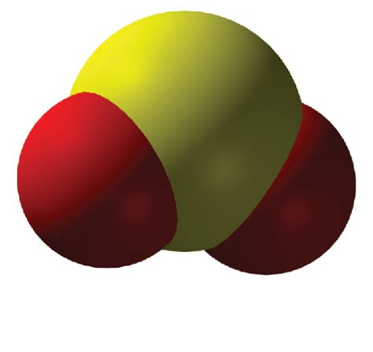
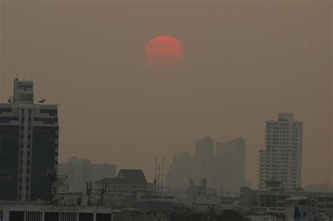
Also in the air close to the ground: “air pollution”
Gases (you can’t see these)
CO (Carbon Monoxide)
SO₂ (Sulfur dioxide)
Aerosols (you can see these)
Particulate matter (PM2.5, PM10)
Sulfates (SO4)

